Slide 1
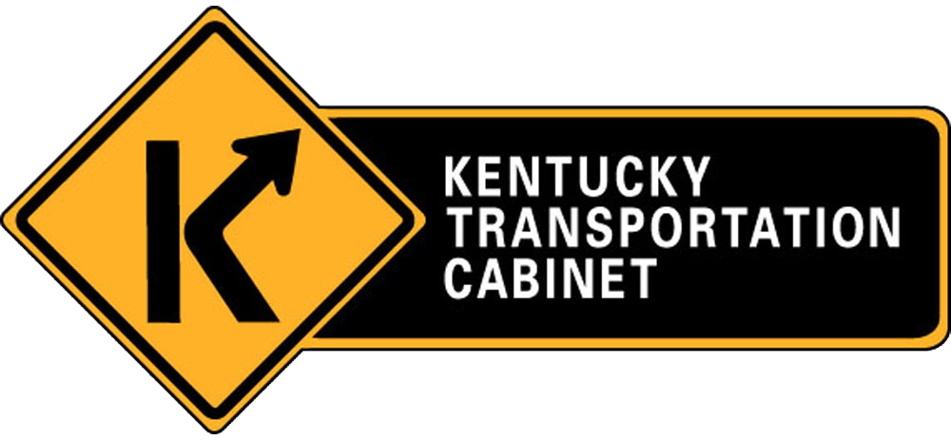
KYTC TAMP Development
Annual Section Engineer Conference
February 8, 2018

Slide 2
Presentation Topics
Motivation for Developing the TAMP
Federal TAMP Requirements
Other Federal Requirements Related to Asset Management
The TAMP Development Process
Potential Impacts
Questions

Slide 3
What Is A TAMP?
A TAMP is:
A document outlining your 10-year investment strategies for preserving existing assets
It enables you to “tell your story”
It is data-driven and performance-based
It focuses on smart, long-term investments

Slide 4
Why Prepare a TAMP?
FHWA requires a TAMP under legislation
Initial TAMP due April 30, 2018
Fully-compliant TAMP due November 20, 2018
Must be updated at least every 4 years
But there are other reasons to develop a TAMP:
Demand on the system is increasing
Assets are aging
Funding doesn’t match needs

Slide 5
What Is Required?
At a minimum, the TAMP must include:
Asset management objectives
Performance measures & targets
A summary description of asset conditions
Gaps between actual & desired performance
A life cycle plan
A risk management analysis
A financial plan
10-year investment strategies

Slide 6
Additional Requirements
Minimum standards for pavement and bridge management systems to support the analysis
Minimum condition requirements for Interstate pavements and NHS bridge decks

Slide 7
Who Is Developing the TAMP?
Applied Pavement Technology, Inc. (APTech) is leading the effort, with support from:
CDMSmith
StarIsis
Albright Engineering

Slide 8
When Will It Be Done?
Draft submitted for review by March 1
Submitted to FHWA by April 30

Slide 9
KYTC Team
Core Team
Jason Siwula, Project Manager
Jon Wilcoxson
Tracy Nowaczyk
Erin Van Zee
Evan Dick
Josh Rogers

Slide 10
TAMP Chapters
Introduction
Objectives
Inventory and Condition
Life Cycle Plan
Risk Analysis
Financial Plan and 10 Year Investment Strategy
Planned Enhancements
Drafts Submitted
Under Development

Slide 11
Introduction
Public facing document
Accompanying guidance document that will include more detailed information.

Slide 12
Objectives
Describes how KYTC manages pavements and bridges.
Meets Federal requirements (23 CFR 515 and 23 CFR 667)
Connects pavement and bridge management to 6 year plan, long range plan, and the new SHIFT process

Slide 13
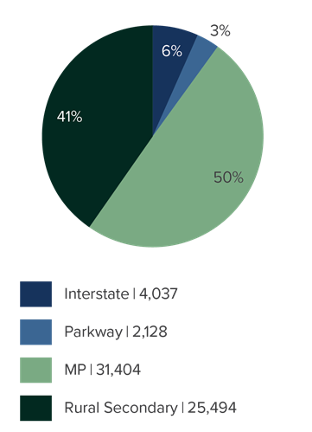
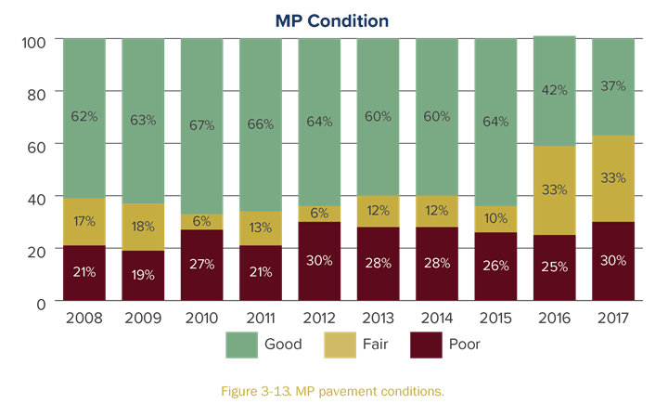
Inventory and Condition
MP System Condition Trends
Mileage by System
Notes:
Presents pavement and bridge ages and conditions
Estimates the value of these assets
Describes current average costs for the types of preservation, maintenance, repair and rehabilitation projects executed in KY
Uses data from BrM, PMS, NBI, Planning, Budget, and Fiscal Management

Slide 14
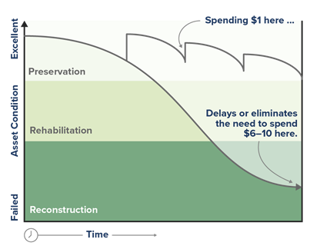
Life Cycle Plan
Considers strategies that reduce the annual cost of preserving the system
Notes:
Looked at the ages of our assets, their conditions, and our current spending patterns to determine:
What strategy provides the best long-term conditions?
Compared multiple strategies at the same budget level
SMEs include
Core Team
Bridge Management Team
Pavement Management Team

Slide 15
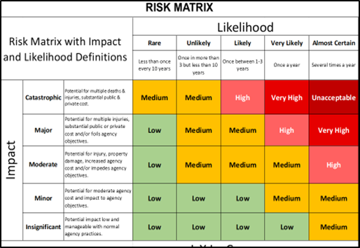
Risk Analysis
What uncertainties may prevent us from achieving our goals?

Slide 16
Types of Risks
The current budget process –Other risks include:
Funding uncertainty
Personnel changes
Natural disasters
SMEs include: Core Team, Pavement and Bridge Management Team, John Moore, Megan McLain
Notes:
Our 10-year plan has to be approved by 136 folks every 2 years after we have the support of the Executive leadership and the Governor

Slide 17
Financial Plan & 10-Year Investment Strategy
The TAMP will address investment needs for pavements and bridges through 2028
Funding scenarios will be realistic but will also be tied to condition targets
SMEs in this area included:
Core Team
Robin Brewer
Bob Drakeford
Jessica Scott

Slide 18
Planned Enhancements
Pavement and bridge management systems will be updated
The TAMP will be resubmitted before June 30, 2019, and updated at least every 4 years afterward
Future TAMPs may address
Additional assets
Additional data on pavements and bridges
More accessible data

Slide 19
What Could This Mean For You?
Doing our jobs better – stronger/ faster/ smarter
Safer crews – less time in work zones reacting to pavement conditions
Better pavement and bridge conditions can lead to time and funding to address assets that traditionally receive less attention
Better investment decisions and funding will allow us to keep more pavements in better condition longer
Increase in numbers and types of preventive maintenance projects

Slide 20
What Could This Mean For You?
Pavement deterioration models will enable us to scope preventive maintenance, scheduling and planning for them with funding
Pavement preventive maintenance responsibilities will include making sure the projections are on track
FHWA will require a review to determine if we’re hitting 2 and 4-year pavement condition targets
Systematic preservation activities for bridges

Slide 21
Are Other States Doing This?
The Ohio DOT released this video to promote their new way of doing business
https://www.dot.state.oh.us/AssetManagement/preservation/Pages/Preservation-Video.aspx

Slide 22
Questions?

